Slide 1

Introduction to Phaser.io:
A framework/engine for building HTML games
By Jelmer Pijnappel

Slide 2
What is Phaser?
Open source HTML5 game framework for mobile and pc
Some features of Phaser:
Input handling (Keyboard/Mouse/Mobile)
Device scaling
Rendering (using WebGL or canvas)
Sprites with animation
Particle effects
Tilemaps
Positioning and camera
Sound/Music

Slide 3
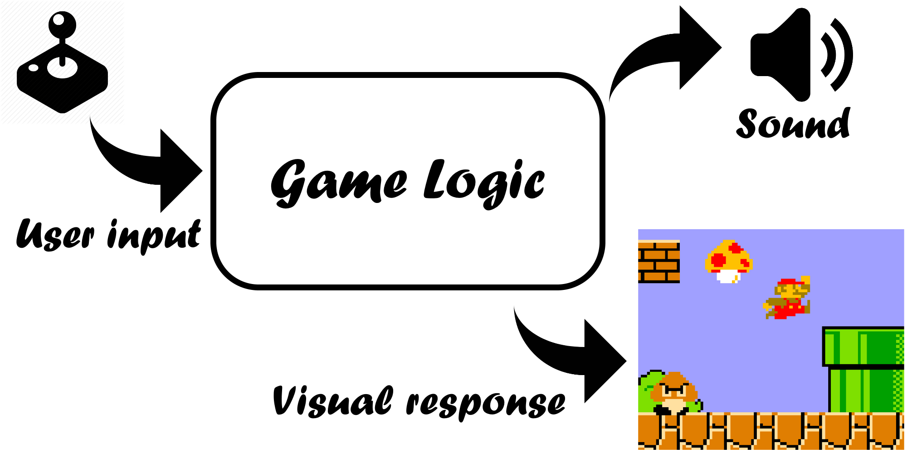
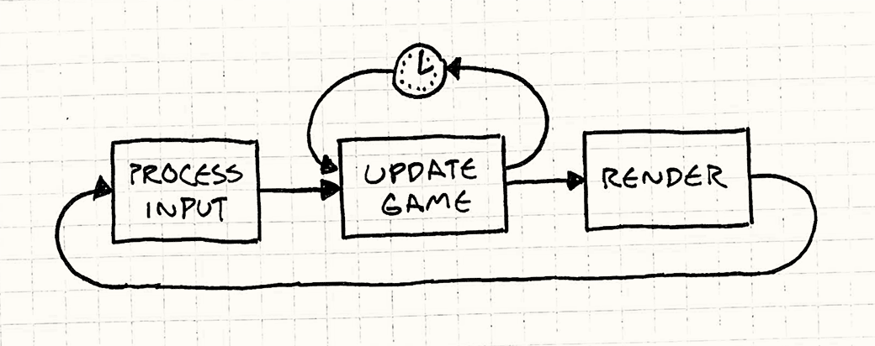
How does a video game work?
User input and computer response
Typically through visuals and sound
Code can only do 1 thing at a time
Typical game loop:

Slide 4
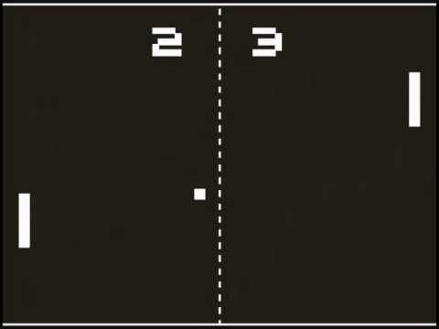
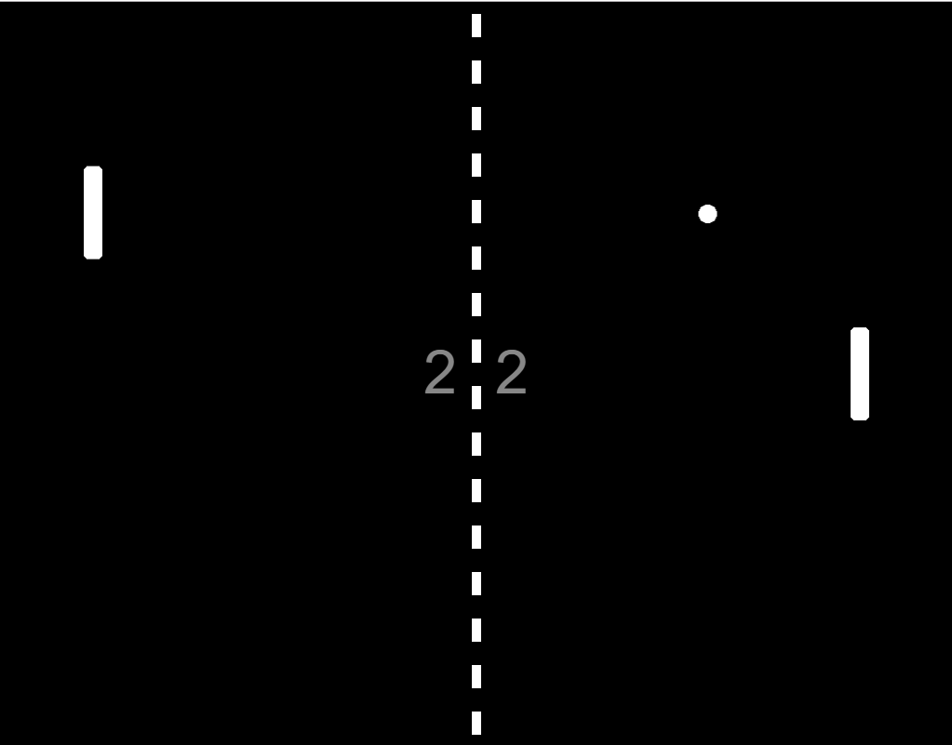
What will we be making?
A simple game of Pong
First Pong version Our Pong version

Slide 5
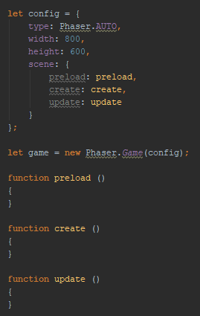
Phaser setup
Config sets up the base settings of your Phaser game.
Phaser.AUTO means phaser will try to use WebGL, but if the browser does not support this it will use canvas.
Preload is run before the game loop starts
Create is run to create all game object in the scene
Update is run continuously to process game logic

Slide 6
Phaser workshop
Phaser 3 (released since March 2018)
Repository (https://github.com/PijnappelJ/phaser-engine)
Other resources, not required for this workshop:
Phaser website with tutorials: https://phaser.io/
Theory on game loops: http://gameprogrammingpatterns.com/game-loop.html

